Slide 1
AutoServe1 DVI – Made Easy!
Easy to Use
Easy to Train (20 minutes)
Easy for Customers

Slide 2
AutoServe1 DVI – Made Easy!
Easy to Use
Easy to Train (20 minutes)
Easy for Customers

Slide 3
Trend # 1 – More Women Customers
The New Majority
Decide How Money is Spent
Want to Better Understand

Slide 4
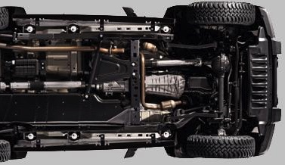
Trend # 2 – Longer Life
Vehicles Are Built Better
Repair Was Easy to Sell (3 decades ago Average Age of Vehicles in Operation (VIO) was 8 years.)
Maintenance is Growing (The average odometer is 160,000 miles)
Repair is Harder to Sell - Educate (Today VIO is 12 years and continues to rise due to overall vehicle quality improvements)

Slide 5
Trend # 3 – Millennials & Smart Phones
82%
Text messages read in 5 minutes.
Email 1+ hour. Voicemail 2+ hours.

Slide 6
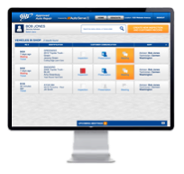
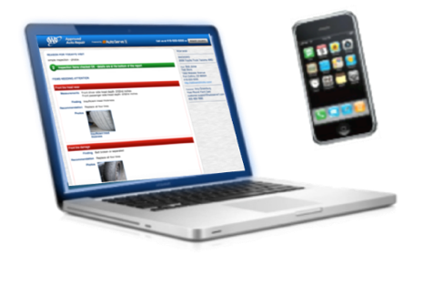
Old Way vs New Way
TRUST
EDUCATE – CLOSE

Slide 7
Key Problem – Painful Trust Gap
66%
73%
of Motorists Do Not Trust Auto Repair Centers
Claim the #1 Reason is that they feel they were recommended unnecessary repairs.
*** AAA Survey – 12/2016 *** Most U.S. Drivers Leery of Auto Repair Shops

Slide 8
Auto Shop Sales Impact – Rolling Out DVI
NO DVI
YES DVI
+25.3 %
-2.9%

Slide 9
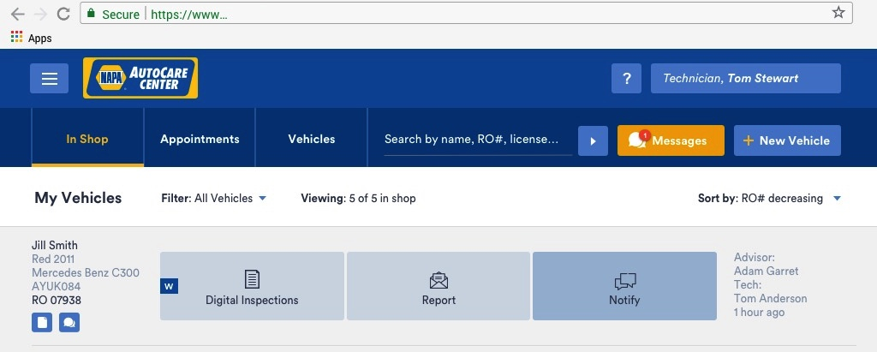
Demo of the New AutoCare DVI
Click Here to Watch – https://as1.wistia.com/medias/babdxxz76p

Slide 10
DVI Integrates with Major Shop Systems

Slide 11
AutoCare DVI Base Products Includes
AutoCare DVI Base Product
12-Month Subscription
One-Time Set Up Fee $499
Monthly Billing $29*/Mo.
* Freedom to choose upgrades
Integrated With Major Shop Systems
Easy To Use – 20 Minutes Of Training
Run Up To 3 Technicians
Shoot Photos & Videos
Two-way Texting (1,000 Included/Month)
Timer Tracking On Inspections
VIN Decoder
History Of All Inspections

Slide 12
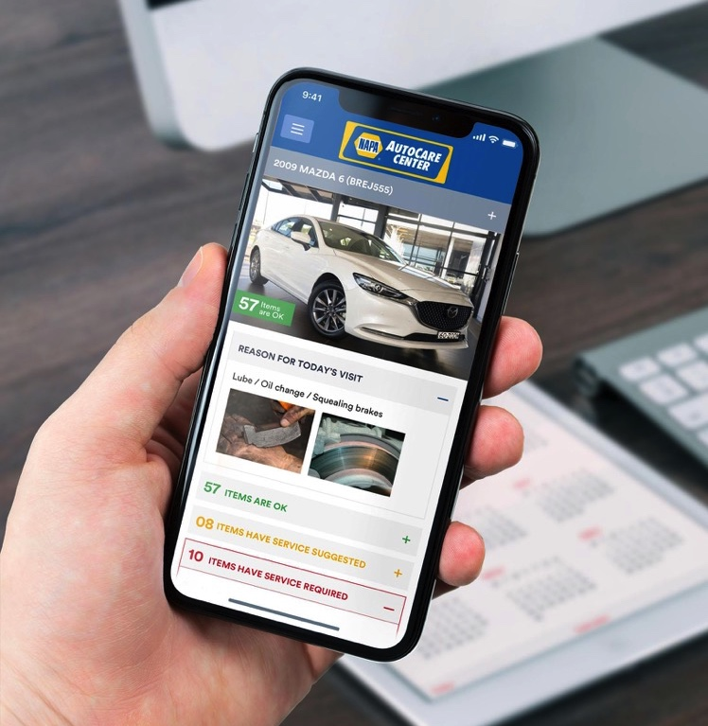
Special NAPA Promotion – Save 70% at Expo
Item | DVI Fee
One-time Set up | $499
12 months of fees (12 x $29/month = $348) | $348
Total Fees Year 1 | $847
Less NAPA EXPO PROMOTION Free Set up | $499 $0.00
Less NAPA EXPO PROMOTION First 3 months $0 | $87 $0.00
New Total Fees Year 1 (save nearly 70%) | $261

Slide 13
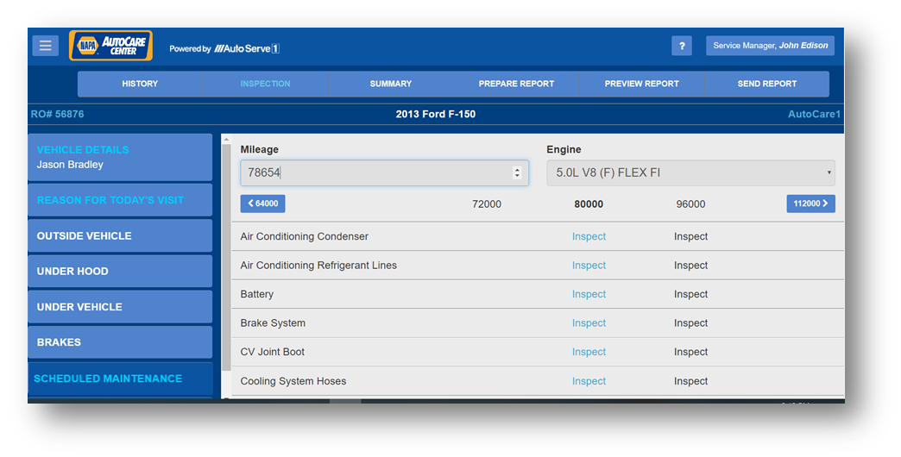
AutoCare DVI Plus – $58/month (+1,000 TEXTS + MOTOR OE Scheduled Maintenance)
Technicians save time with instant access to MOTOR OE Scheduled Maintenance.
Customers receive
OE Scheduled Maintenance in reports to back up store recommendations for quick approvals.
To Enroll - check AUTOCARE website or go to www.autoserve1.com/NAPA.

Slide 14
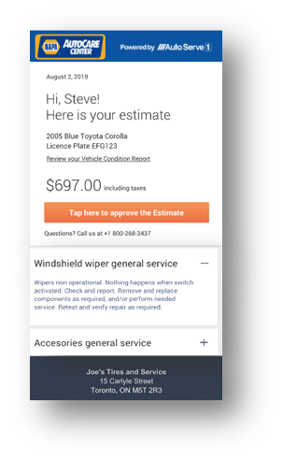
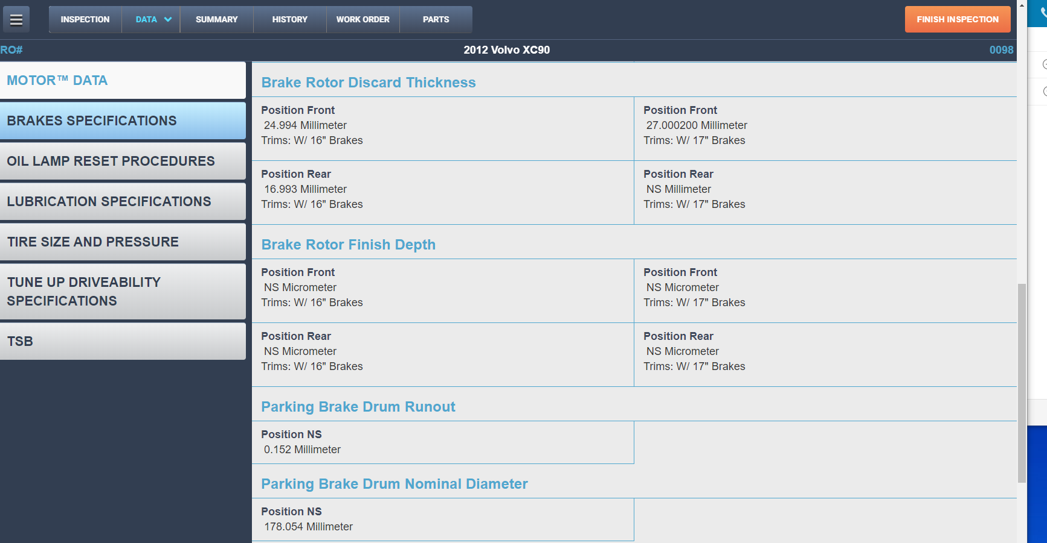
AutoCare DVI Pro – $88/month (Mobile payment approval + MOTOR Discard Specs on Tablet)
Advisors send estimate totals to phones for instant approvals.
Technicians save time with instant access to VIN matched MOTOR Vehicle Parts Discard Specifications.

Slide 15
AutoCare DVI Premium – $108/month (Expanded Workflow – 2X the check points for vehicle progress)
Service Advisors and Technicians save time by seeing vehicle exact status of approvals and parts in stock or on order to optimize workflow in the front and back of the shop.

Slide 16
How DVI Bridges Trust Gap
Click Here to Watch - https://as1.wistia.com/medias/wgg8ybgnj1?wvideo=wgg8ybgnj1

Slide 17
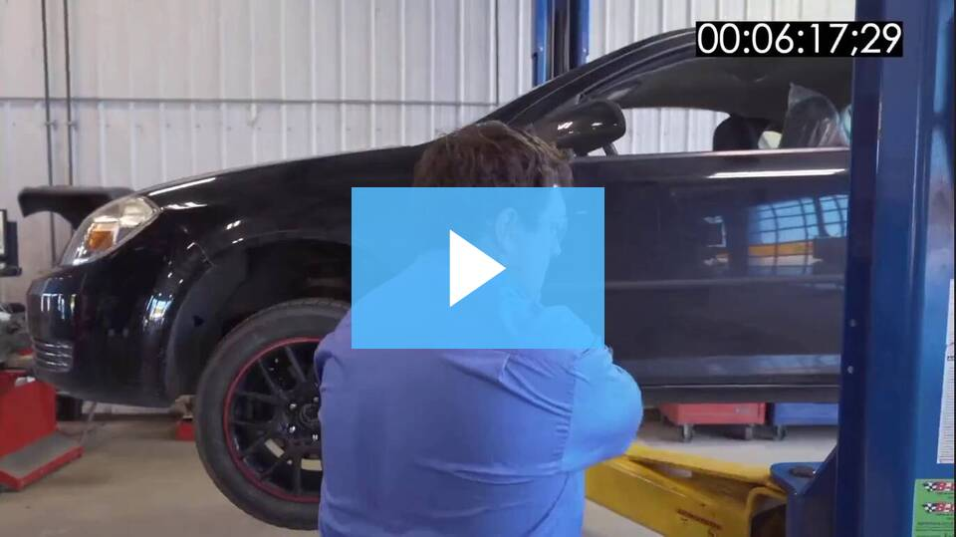
See DVI In Action
Click Here to Watch - https://as1.wistia.com/medias/4zfyl4uv7d

